Slide 1
Online Sales Performance
Data findings for performance review & growth opportunities
Wenyi Zhou
Notes:
Welcome to the presentation. The focus for this presentation is to review the businesse’s online sales performance and present the data findings.

Slide 2
Agenda
Introduction: business question and approach for data analysis
Data Exploration: contributing factors and growth potential
Summary and insights
Notes:
Firstly, I will give an overview for the business context as given by our customers, and the major approach I followed for data analysis, followed by the summary of insights from the data.

Slide 3
Introduction
Context: online retail business
Business question:
Review major contributing factors to sales and revenue
Inform strategic planning for expansion opportunities
Approach to Data analysis:
Sales trend by months: which month showed increase / decrease in sales revenue?
Top 10 countries contributing to the sales revenue
Top 10 customers contributing to the sales volume, and recency, frequency and monetary values by customer types
Notes:
The business is in the online retail sector with a range of product categories.
The focus question for this presentation is on the major contributing factors for sales and revenue to inform strategic planning for expansion opportunities.
The data was analysed from three perspectives: the monthly trend for sales, the top 10 countries and individual customers generating the highest revenue, as well as an overview of RFM values for different types of customers.

Slide 4
Data Exploration
Data Quality Assessment
 | Summary Statistics | Accuracy | Validity
Online Retail Dataset | Total transactions recorded: 4,740,656 Geographical: 39 countries Time range: Dec 2010 – Dec 2011 | Quantity：below 1 unit (11.4%) Unit Price: below zero (order returned) Solution: Filtered out | Quantity: format Unit Price: format
Notes:
The data provided recorded over 4 millions of transactions across 39 countries from Dec 2010 to Dec 2011. The major issues dealt with was the accuracy of quantity, with some below 1 unit, and unit price below zero. The transactions were filtered out as they may have been returned orders which does not serve the purpose of this analysis.

Slide 5
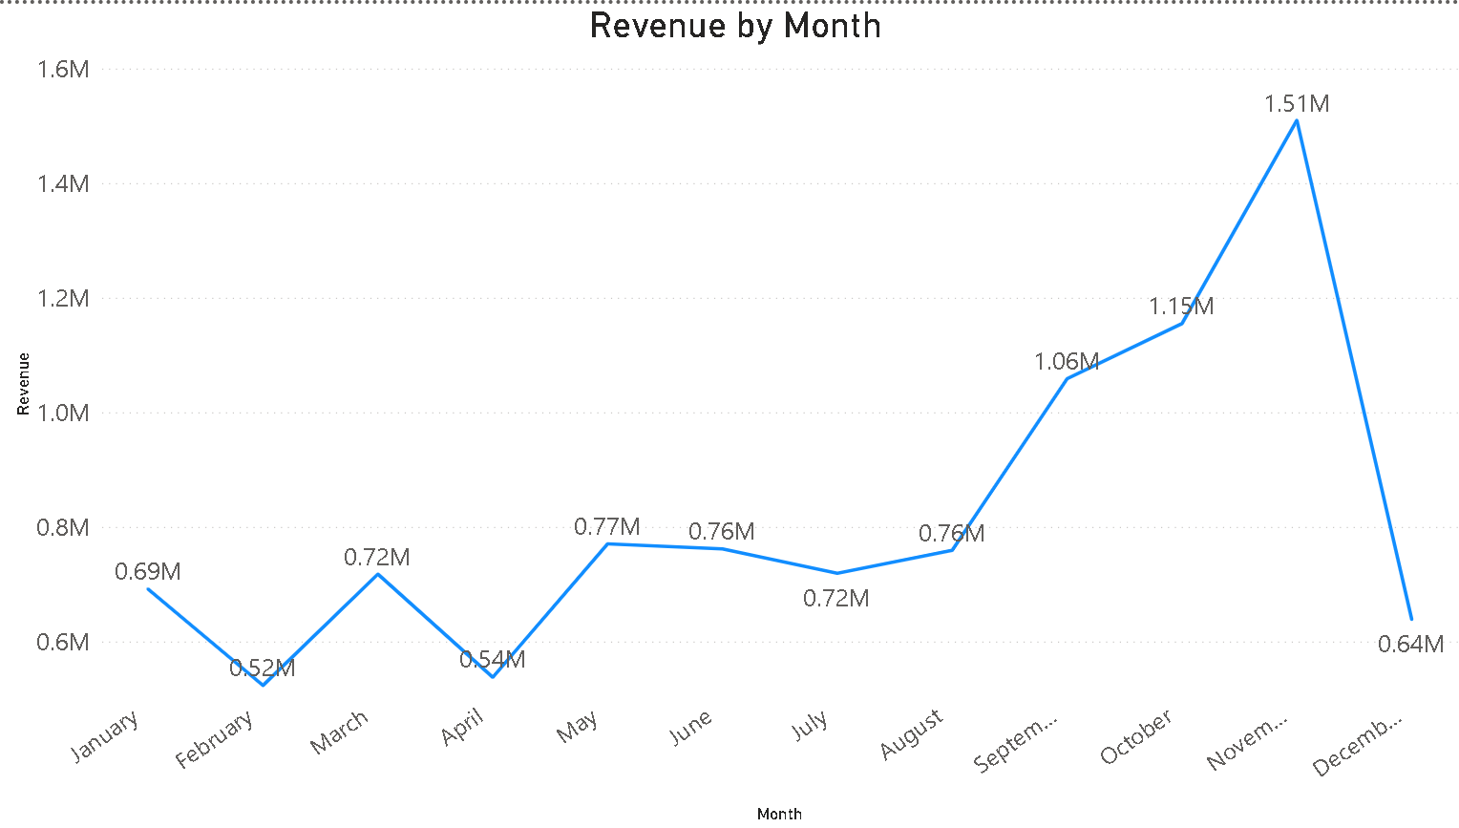
Monthly trend of sales revenue in 2011
Sales performance ranged from $520,000 – 1,510,000 million
There was a steady increase from April to November, where it reached a peak of $15100, followed by significant decrease of $ 90,000 until December
Notes:
Overall, the monthly sales revenue in 2021 ranged from 0.52 million to 1.51 million dollars, with a steady increase from April to a peak of 1.5 thousand in November, with a almost three fold decrease in the following month, to 0.64 million in December.

Slide 6
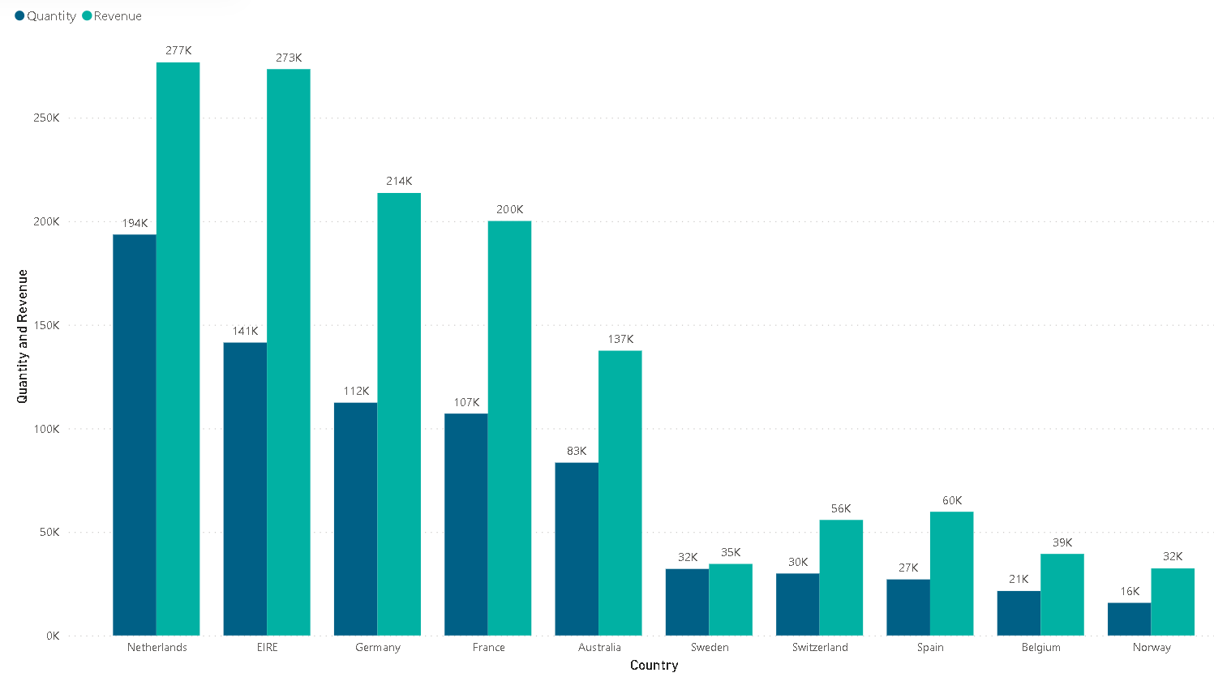
Top 10 countries generating the highest revenue
Netherlands and EIRE generated the highest sales revenue
Most countries with high revenues among APAC and EMEA regions
There were 4 countries with a yearly revenue of over $200,000
Notes:
Looking at the major countries contributing to the sales, The top 10 countries were Netherlands, EIRE, Germany, France, Australia, Sweden, Switzerland, Spain and Belgium, mostly among the APAC and EMEA regions.
Four countries had higher than 2 million dollar revenues, namely Netherlands, EIRE, Germany and France, which are all in Europe.

Slide 7
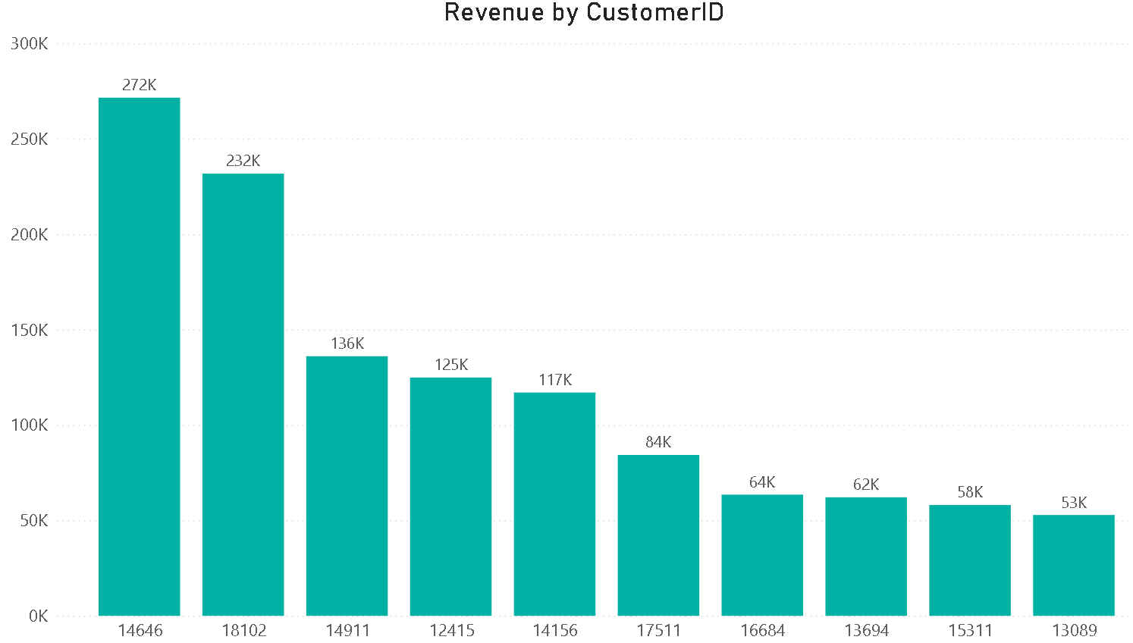
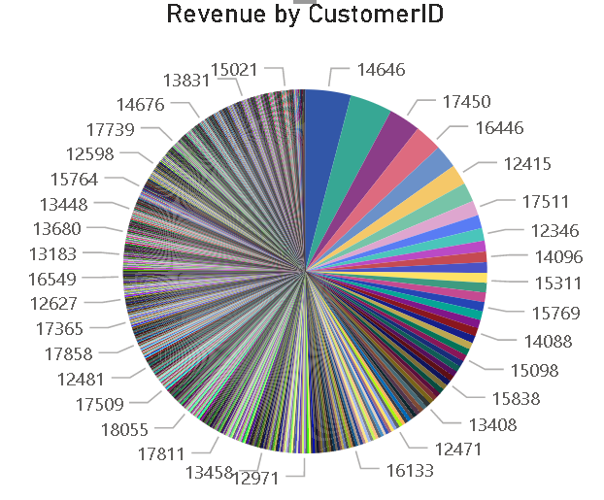
Top-10 customers generating the highest revenue
Revenues generated by the top 10 customers ranges from $ 53,000 to $ 272,000 in 2011
Customer base is diversified with less dependency on particular customers
Notes:
The top 10 customers generated between 50 to 272 thousand of revenue individually. The pie chart shows revenue by each customer ID, which demonstrates that the company has a diverse customer base, and is less dependent on particular major customers, while there is a potential to encourage more customers to become higher revenue-generating customers.

Slide 8
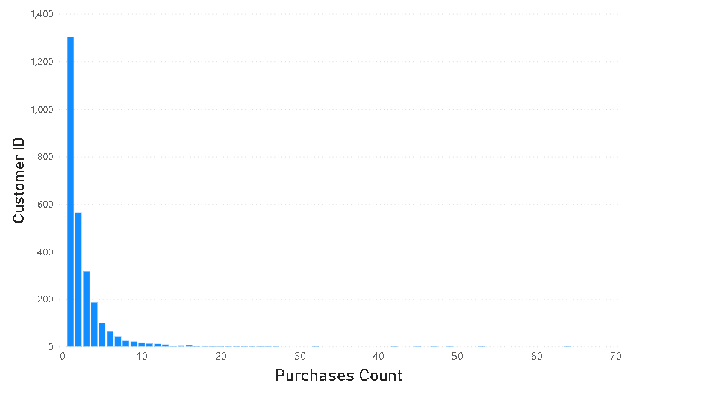
Differences in purchase frequency between customers
Data shows, purchase frequency for majority of customers are below 10 in 2011.
Approximately 1000 customers made 2-4 purchases
Approximately 1300 customers made only 1 purchase
Notes:
Most customers made less than 10 purchases over the year, whereas 1300 customers made only 1 purchase. The reason for a lack of coming back should be explored, whereas around 1000 customers who made 2-10 purchases are the most likely spot for growth.

Slide 9
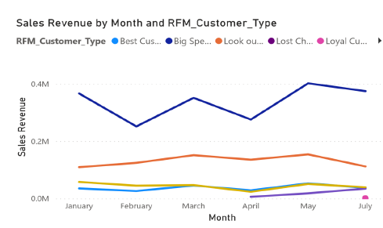
Differences in purchase frequency between customers
Data shows, the highest sales volume was generated by the ‘big spenders’, followed by look out buyers.
The ‘best customers’ contributed less to the overall sales revenue. However, they are the most frequent buyers among other categories.

Slide 10
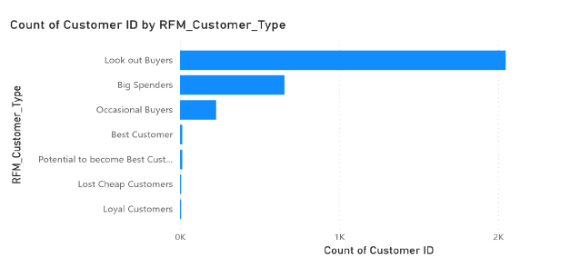
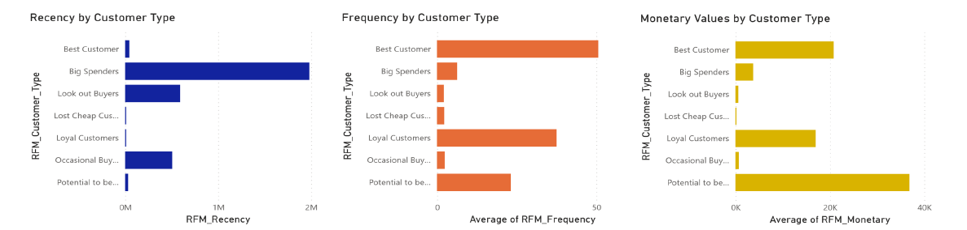
RFM values by customer type
The lookout buyers showed the highest RFM values, followed by the big spenders
The reason for the low RFM value of loyal customers can be that their less recent purchases
Notes:
The RFM chart shows a high RFM value for lookout buyers which further shows the value to encourage these customers to make more purchases, and loyal customers should be targeted as their purchases are less recent than other customers. The data shows the big spenders has high recency values, which should be targeted to become frequent buyers too.

Slide 11
Summary of findings and insights
In 2011, monthly sales performance ranged from $52,000–151,000, with a peak at November and a significant decrease until December
EIRE, Netherlands and Germany generated the highest sales quantity and revenue, while top 10 revenue generating countries were located in the APAC and EMEA regions
The business has a diversified customer base, while the big spends and lookout buyers who made recent purchases should be encouraged to become more frequent purchasers.
Notes:
In summary, monthly sales in 2011 typically ranged from $52,000 to 151,000, with a peak at November and significant decrease in the following month.
EIRE, Netherlands and Germany….

Slide 12
Thank you!

